Slide 1
Pets Galore!
Want to adopt a pet?

Slide 2
Description
Our application helps people adopt a pet in need. There is also a page on our website for fantasy animals where people can browse through for their own amusement.

Slide 3
Motivation
We chose to use the idea of adopting a pet for our application instantly. Some of our team members are pet owners and hearing how they enjoy being with them inspired the rest of the team members. We were talking about pets long before the project started.

Slide 4
Program Map:
We used the program map above to define the overall outline for the product’s functions.
Some of the outlined features were not included in the MVP (minimum viable product), but we’d like to add them in future updates.

Slide 5
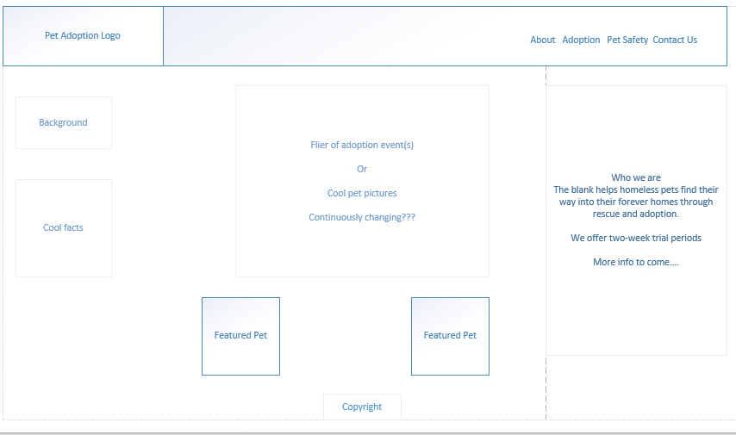
Wireframes: Homepage

Slide 6
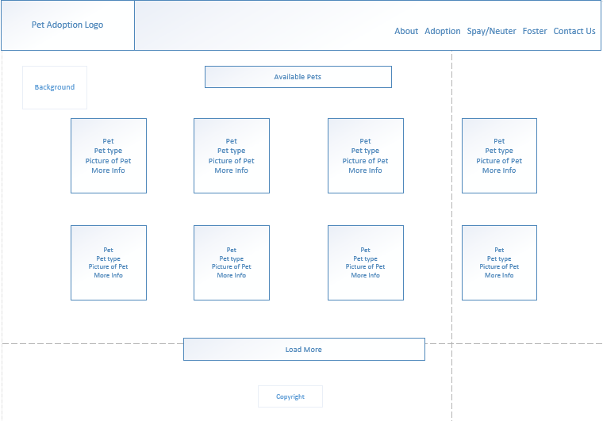
Wireframes: Adoption Pages

Slide 7
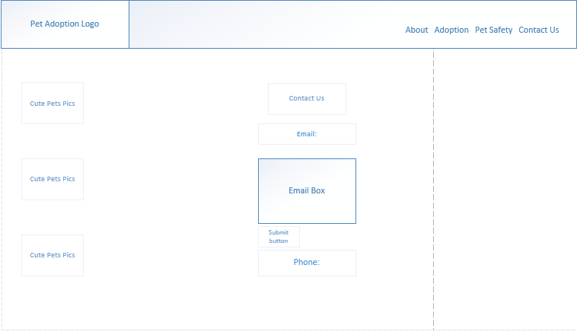
Wireframes: Contact

Slide 8
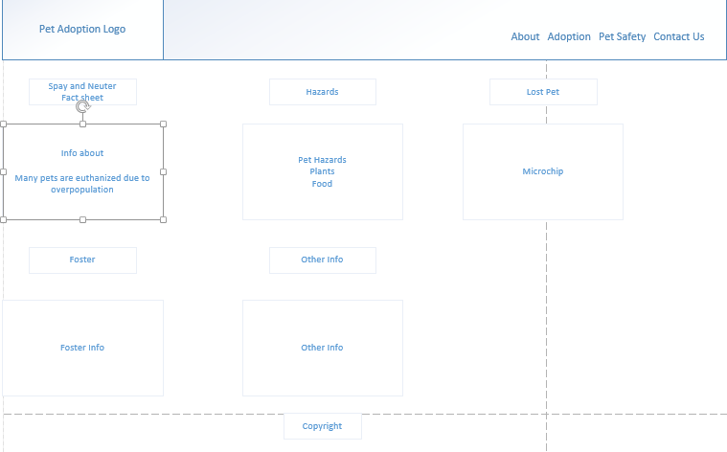
Wireframes: Pet Safety Info Page

Slide 9
Team Effort
Lara was basically a full-stack developer in this app. She worked on both the front-end and back-end of the application. She was also the head of Github.
Emily was the product owner mapping out the tasks in details for us to complete. She created the project maps and worked on the data routes on the backend of the application. She also edited and the PowerPoint.
Zarlashta worked on the back-end of the application, primarily the database, seeds, and models, and adjustments. She also primarily developed the PowerPoint.
Ranock worked on the original wireframes for the front-end of the application, and developed a more robust front-end in addition to our minimum viable product.
Everyone worked on this app together most of the time, troubleshooting and testing each other's code as well as mapping out future tasks.

Slide 10
Challenges
Since we met up together most of the time, we tried to fix each other's problems. We were able to solve our issues together or with the help of a TA.
One of the problems we ran into was that the pictures were not appearing. It was a small problem but took us a little while to fix. The file names didn't match. The paths also had to be updated to be consistent.
We had issues building the database get and post paths as they required a lot of troubleshooting to correctly function end-to-end.
We had challenges at the end integrating the disparate front-end code, html links, and styles that had been developed independently, but were able to iron out the issues.

Slide 11
Results
Using node, Sequelize, MySQL and Handlebars, we were able to create an app that allows users to adopt a pet as well as allowing them to browse through the website of fantasy animals for their amusement.
The main features are:
A database including tables of real pets and fantasy pets, as well as a table which stores the adoption inquiries.
A public-facing website that introduces the organization and allows users to browse and submit adoption requests.
Additional information pages on the public-facing website.

Slide 12
Improvements: Given more time, we’d like to….
Insert more add-ons.
Add a functional interface for the “adoption agency” employees to use to manage the database and the pets displayed on the website in one place.
Add login for the adoption agency’s internal database.
Add more fantasy components.

